Slide 1
CSE 451: Operating Systems
Spring 2010
Module 2
Architectural Support for
Operating Systems
John Zahorjan
zahorjan@cs.washington.edu
534 Allen Center
Notes:
1

Slide 2
Outline
Part 1: Basics of Architecture / OS Interaction
  Largely a review of CSE 378 material
Part 2: The Hardware Architecture and Virtual Machines
  Note: We'll need the basics of the Part 1 basics to understand Part 2...

Slide 3
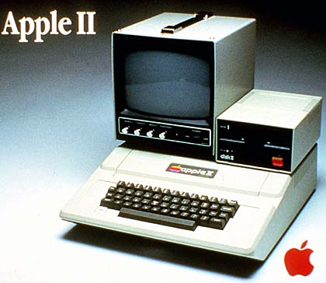
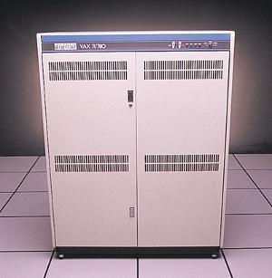
Even coarse architectural trends impact tremendously the design of systems
Processing power
  doubling every 18 months
  60% improvement each year
  factor of 100 every decade
  1980: 1 MHz Apple II+ == $2,000 ($5200)
    1980 also 1 MIPS VAX-11/780 == $120,000 ($312K)
  2010: 3.0GHz Dual Core == $530

Slide 4
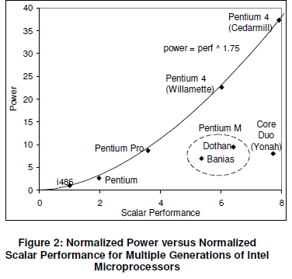
Power Consumption
http://www.intel.com/pressroom/kits/core2duo/pdf/epi-trends-final2.pdf

Slide 5
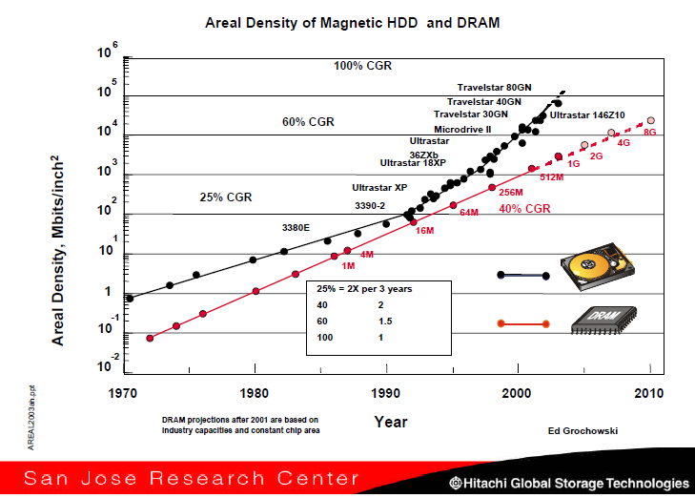
Primary Memory / Disk Capacity

Slide 6
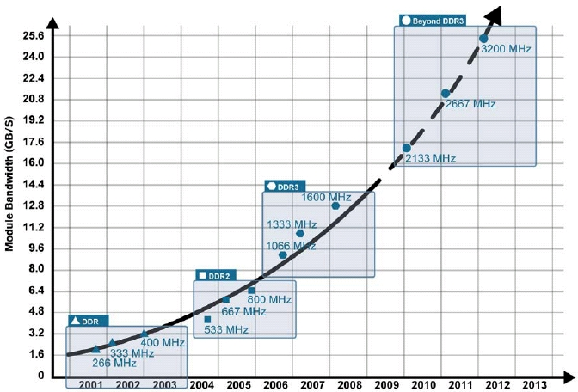
Primary Memory Bandwidth

Slide 7
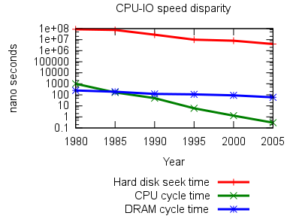
Relative Speeds
http://www.cs.cmu.edu/~amarp/cpu-io-gap.png

Slide 8
<footer>© 2004 Jim Gray, Microsoft Corporation

Slide 9
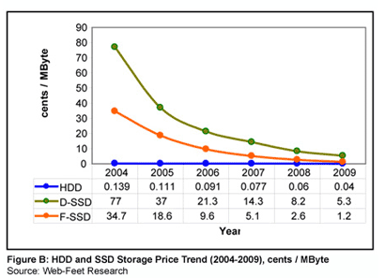
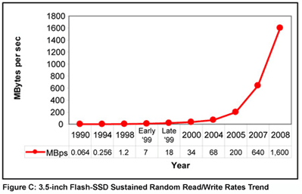
A Current Trend: Solid State Disks
http://www.embeddedstar.com/articles/2005/2/article20050207-4.html

Slide 10
Lower-level architecture affects the OS dramatically
Operating system functionality is dictated, at least in part, by the underlying hardware architecture
  includes instruction set (synchronization, I/O, …)
  also hardware components like MMU or DMA controllers
Architectural support can vastly simplify (or complicate!) OS tasks
  e.g.: early PC operating systems (DOS, MacOS) lacked support for virtual memory, in part because at that time PCs lacked necessary hardware support

Slide 11
Architectural features affecting OS’s
These features were built primarily to support OS’s:
  timer (clock) operation
  synchronization instructions (e.g., atomic test-and-set)
  memory protection
  I/O control operations
  interrupts and exceptions
  protected modes of execution (kernel vs. user)
  protected instructions
  system calls (and software interrupts)
[2006] virtualization architectures
  Intel: http://www.intel.com/technology/itj/2006/v10i3/1-hardware/7-architecture-usage.htm
  AMD: http://sites.amd.com/us/business/it-solutions/usage-models/virtualization/Pages/amd-v.aspx

Slide 12
Protected instructions
some instructions are restricted to the OS
  known as protected or privileged instructions
e.g., only the OS can:
  directly access I/O devices (disks, network cards)
    why?
  manipulate memory state management
    page table pointers, TLB loads, etc.
    why?
  manipulate special ‘mode bits’
    interrupt priority level
    why?
  halt instruction
    why?

Slide 13
OS protection
So how does the processor know if a protected instruction should be allowed?
  the architecture must support at least two modes of operation: kernel mode and user mode
    VAX, x86 support 4 protection modes
  mode is set by status bit in a protected processor register
    user programs execute in user mode
    OS executes in kernel (privileged) mode (OS == kernel)
Protected instructions can only be executed in kernel mode
  what happens if user mode executes a protected instruction?

Slide 14
Crossing protection boundaries
User programs must call an OS procedure to do something privileged
  OS defines a set of system calls
  System calls act like protected procedure calls
A syscall instruction atomically:
  Saves the current PC
  Sets the PC to a handler address
    Writing the handler address is a privileged operation
  Sets the execution mode to privileged
With that, it's a lot like local procedure call (jal):
  Caller puts arguments in a place callee expects (registers or stack)
    One of the args is a syscall number, indicating which OS function to invoke
  Callee (OS) saves caller’s state (regs, other control info) so it can use CPU
  OS function code runs
    OS must verify caller’s arguments (e.g., pointers)
  OS returns using a special instruction (e.g., ERET – i.e., not JR)
    Atomically sets PC to return address and sets execution mode to user

Slide 15
A kernel crossing illustrated
Set up args, including syscall number for “read”
Firefox: syscall instruction
Save user PC;
PC = trap handler address
enter kernel mode
user mode
kernel mode
trap handler
save app state;
verify syscall number
find read( ) handler in vector table
PC = saved PC;
enter user mode
read( ) kernel routine
Verify args;
Execute read()
Set up return values
Restore app state
ERET instruction

Slide 16
System call issues
What would be wrong if syscall worked like subroutine call, with the caller specifying the next PC?
What would happen if kernel didn’t save state?
Why must the kernel verify arguments?
How can you reference kernel objects as arguments to or results from system calls?

Slide 17
Exception Handling and Protection
All entries to the OS occur via the mechanism just shown
  Acquiring privilege mode execution and branching to the trap handler are inseparable
Terminology:
  Interrupt: asynchronous; caused by an external device
  Exception: synchronous; unexpected problem with instruction
  Trap: synchronous; intended transition to OS due to an instruction
Privileged instructions and resources are the basis for most everything:
  Memory protection
  Protected I/O
  Limiting user resource consumption

Slide 18
Memory protection
OS must protect user programs from each other
  maliciousness, ineptitude
OS must also protect itself from user programs
  integrity and security
  what about protecting user programs from OS?
Simplest scheme: base and limit registers
  are these protected?
Prog A
base reg
base and limit registers are loaded by OS before starting program
Prog B
limit reg
Prog C

Slide 19
I/O control
How does the kernel start an I/O?
    special I/O instructions (privileged operation)
    memory-mapped I/O (privileged memory)
How does the OS know an I/O operation has finished?
  Polling (sit in loop asking device if it's done)
  Interrupt (“get back to me when you're finished”)
Interrupts are basis for asynchronous I/O
  OS starts IO operation, then goes on doing whatever
  device performs an operation asynchronously to CPU activity
  device sends an interrupt signal on bus when done
  Interrupt causes a kernel entry

Slide 20
Protected CPU Use: Timers
How can the OS prevent runaway user programs from hogging the CPU (infinite loops?)
  use a hardware countdown timer
    Generates an interrupt when it has counted down to 0
  before it transfers to a user process, the OS sets the countdown timer
    E.g., sets a number that will cause an interrupt in 10 msec.
  now either the user process invokes the OS within the next 10 msec. or the timer goes off
    Either way, the OS has a chance to choose a different process to “dispatch” next

Slide 21
Part 2: Architecture and Virtual Machines
Virtual machines date back to the 1960's
  IBM has had a commercial product since then
A virtual machine is an efficient, software produced “hardware” execution environment
  Efficient: virtual machine user processes run directly on the physical CPU
    Eliminates Java or other software simulators
  Hardware execution environment: any code that would run on an identically configured physical system will run on the virtual machine, including an OS
Because each is like a separate hardware machine, they encapsulate complete namespaces for all resources
  No sharing of names ⇒ Complete isolation
They've undergone a huge resurgence the last decade

Slide 22
Virtual Machines: The Layered View
User
processes
User mode
execution
OS
OS
Guest OS's
Virtual Machine Monitor
Kernel mode
execution
Hardware

Slide 23
Temporal Snapshots
OS
OS
VMM
CPU
CPU
CPU
CPU
The user process is executing in user mode, as expected
The guest OS is executing in user mode, which it isn't expecting
The VMM is executing in privileged mode, which it expects expecting

Slide 24
Basic Ideas
When any kind of exception or interrupt occurs, we'll end up in the VMM, rather than the guest OS
  VMM simulates state changes that would have been made by the hardware, then restarts VM at the guest OS handler address
    E.g., stuffs the saved PC where the architecture says it should be
When the guest OS tries to execute a privileged instruction:
  Same thing
What's so hard?
  Not all instructions that require VMM intervention may be privileged
    Depends on the architecture

Slide 25
An Example Problem
Suppose the ERET instruction (return to user process after handling exception) is not privileged
  ERET sets the PC to the saved PC, and
  Sets CPU privilege mode to user
  There doesn't seem to be a reason to prevent user processes from doing that (even if there's no reason for them to want to)
The problem for VMMs:
  They have to track the virtual CPU protection level to know how to respond to a privileged instruction exception
    When the virtual CPU state is privileged, the VMM should execute the effect of the privileged instruction
    When it's user, it should execute the effect of a privileged instruction exception on the virtual machine
  They therefore have to know when the guest OS executes an ERET
Whether or not virtualization is possible depends on the hardware architecture

Slide 26
“Formal Requirements for Virtualizable Third Generation Architectures”
Popek and Goldberg, 1974
  A local copy is available at http://www.cs.washington.edu/education/courses/cse451/10sp/protected/popekGoldberg.pdf
A virtual machine is:
  Efficient: only minor slowdowns for user processes
  Isolated: the VMM controls physical resource allocation, not the guest OS
  A Duplicate: programs get the same results as on physical machines, modulo resource availability and timing issues
    Virtual machine configuration is smaller than the physical machine (less memory, less disk, …)
    Virtual machine may have more or fewer devices
      More disks, for example

Slide 27
When Can An Architecture Be Virtualized?
It helps to identify three classes of instructions
  Privileged
    Cause a trap when executed in user mode
  Sensitive
    Control Sensitive
      Instruction changes machine mode (user/privileged) or control settings (e.g., memory mapping)
    Behavior Sensitive
      Instruction gets different results (including next PC value) depending on machine mode, or the real addresses of things
        S/360 Load Real Address (LRA) instruction
  Innocuous
      Everything else

Slide 28
Formal Results
THEOREM 1. For any conventional third generation computer, a virtual machine monitor may be constructed if the set of sensitive instructions for that computer is a subset of the set of privileged instructions.
(Theorem 2: If you can virtualize, you can recursively virtualize.)

Slide 29
x86 Architecture
Doesn't meet the Popek & Goldberg virtualization criteria
There are many reasons, but most of them stem from behavior sensitive instructions that don't fault in user mode
  These are “safe” operations, when not implementing virtual machines, and so not privileged
  E.g., reading control values (like page table pointers) is not a privileged operation
The physical page table pointer registers must be set to what the VMM wants, not what the guest OS expects
  If the guest OS reads them, there's no chance for the VMM to fix up the results of the read, and the guest OS gets confused
So, how is the x86 being virtualized?

Slide 30
Virtualizing the x86: Software Approach
Basic idea (as always):
  Execute innocuous instructions natively
  Trap on sensitive instructions and simulate their effect
How do we find the sensitive instructions?
  Once the instructions are running natively, there's no trap when needed
  Could simulate all instructions, but...
    That isn't really a virtual machine, in the sense we mean here, because it's too slow
Approach: find them statically, not dynamically
  “Read the source,” not the stream of executing instructions
  When you find a sensitive instruction...
    What do we need to do here?
      Remember, I want the innocuous instructions to execute natively, and the sensitive ones are hiding in their midst

Slide 31
Binary Rewriting
The VMM will have control whenever a code page is being loaded
  Loading code involves setting page table permissions
  That involves a privileged instruction
When the page is loaded
  Scan the instructions it contains, looking for the sensitive instructions
  Replace them with something that will cause a fault
  Remember the instruction that used to be there
  Now allow native execution of the code page
This is the original approach used to grapple with the x86 by the VMMs you've heard of (e.g., VMWare), and is still in use

Slide 32
Virtualizing x86: The Hardware Approach
Both Intel and AMD have developed virtualization extensions to the architecture (starting ~2006)
  Intel: VT-x
  AMD: AMD-V
To get correctness, they introduce new machine modes and duplicate the problematic state
  New modes: VMX root (actual root) and VMX non-root (you think you're root, but you're not)
  One sees the actual control information; the other sees a decoy copy, whose contents are controlled by the VMM
    Turns a behavior sensitive instruction into an innocuous one
  Additionally, many previously non-faulting instructions cause a fault when in VMS non-root mode
The extensions also provide some efficiency improvements
  E.g., they know that guest OS and VMM page tables need to be composed

Slide 33
(Aside) An Alternative SW Approach: Paravirtualization
Don't try to create a duplicate of hardware; create something useful and similar
  Define result of problem sensitive instructions as “undefined”
  Introduce new architectural features that improve virtual machine performance
    New instructions: idle-with-timeout instruction (rather than idle loop)
    Slightly higher level of abstraction for hardware device interfaces than hw provides
Because it's not a duplicate, some modification of the guest OS may be required
While you're at it, address some performance issues that trouble even virtualizable architectures
  Example: Both the VMM and the guest OS are managing paging
    Duplication of effort
    Guest OS doesn't actually know what the state of memory is
    Resolving a fault requires composing the guest OS and VMM page tables
  Solution: remove paging from guest OS
Qualitatively, paravirtualization is to virtual machines what hints are to caches
  We change the problem definition slightly, and end up with much higher performance implementations

Slide 34
OS/Architecture Summary
Some architectural features are required to run an OS in a reasonable way and user processes at full machine speed
  (At least) two modes of operation (privileged, user)
  Privileged instructions
  Memory protection
  Interrupts / exceptions / timers
We'll be seeing more of virtual machines for the foreseeable future
  Their efficiency, and in fact the ability to create them at all, is strongly affected by the architecture
  Architectural features are evolving explicitly to provide better support for them

